Slide 1

TC3003: Diseño y Arquitectura de Software
Dr. Juan Manuel González Calleros
Email: jmgonzale@itesm.mx
Twitter: @Juan__Gonzalez
Facebook: Juan Glez Calleros
Reuniones pedir cita

Slide 2
Adapter Pattern
Notes:
Prueba para notas - Prueba para notas

Slide 3
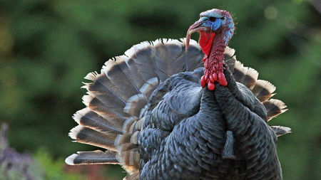

Slide 4
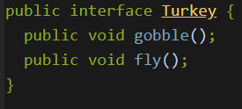
Turkey behaviors

Slide 5
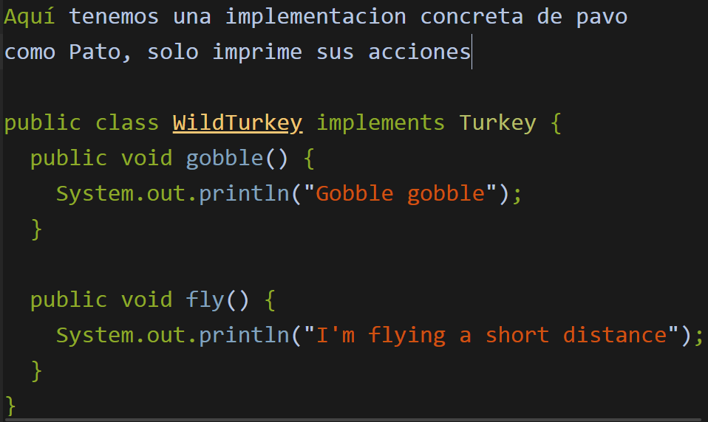
Simple implementation

Slide 8
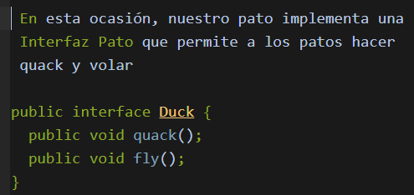
Duck behaviors

Slide 9
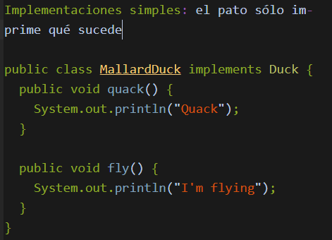
Simple implementation

Slide 10
Turkey to behave as Duck but still behaving as turkey

Slide 11
How to do that?
Turkey to behave as Duck but still behaving as turkey while doing that

Slide 12
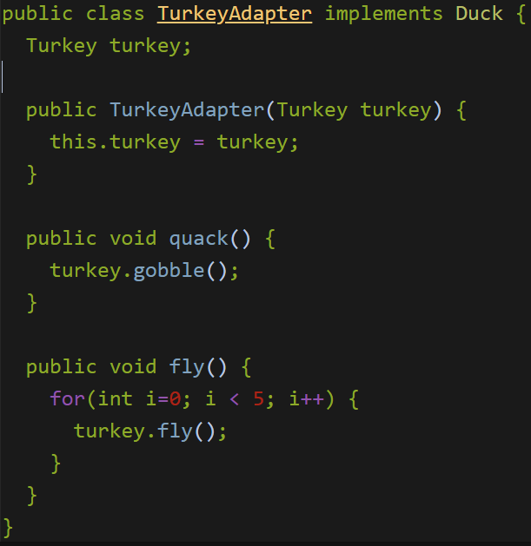
Turkey to behave as Duck but still behaving as turkey while doing that

Slide 13
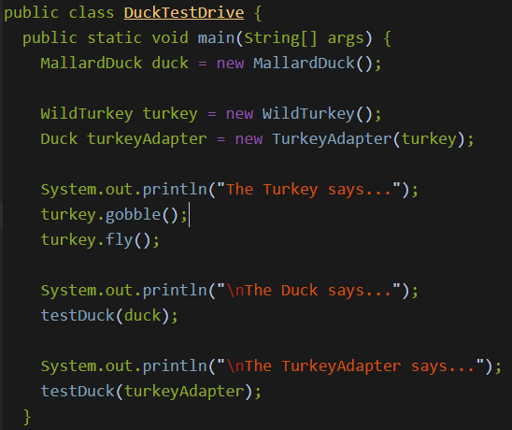
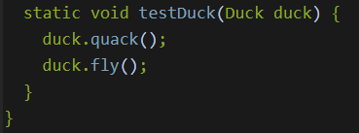

Slide 14
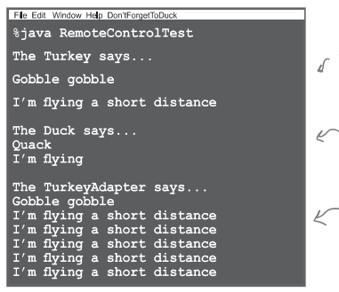
Results

Slide 15
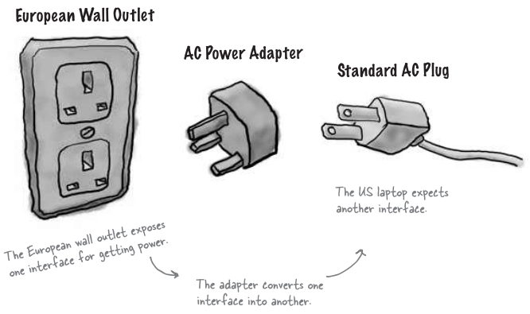
Notes:
adwad

Slide 16
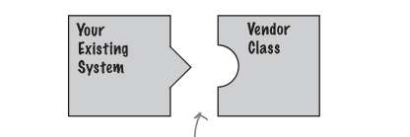
The new interface does not fit in the existing one.
It is not going to work!

Slide 17
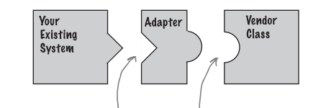
The adapter implements the interface and communicates with the interface of the
that our classes expect.

Slide 18
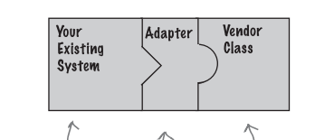
No change New Code No Change

Slide 19
Adapter Pattern
The Adapter design pattern converts the interface of a class into another interface that the client expects. Adapters allow classes to work together when they otherwise could not, due to incompatible interfaces.

Slide 20
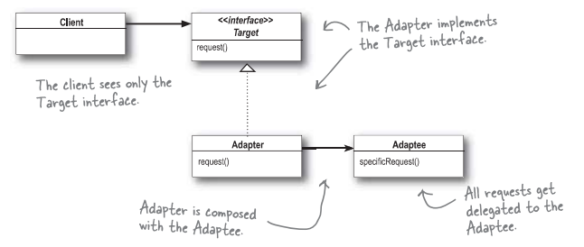
Class Diagram with Interfaces

Slide 21
Class Diagram with Interfaces
TurkeyAdapter

Slide 22
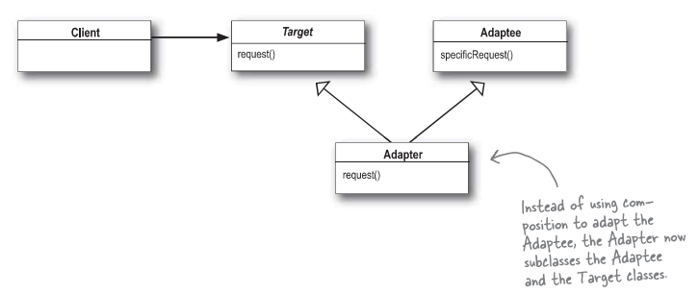
Class Diagram with Classes

Slide 23
Class Diagram with Classes
TurkeyAdapter

Slide 24
Mouse Event Handling
Event-listener interfaces for mouse events
MouseListener
MouseMotionListener
Listen for MouseEvents

Slide 25
MouseListener and MouseMotionListener interface methods

Slide 26
MouseTracker.java Lines 20-21
1 // Fig. 13.17: MouseTracker.java
2 // Demonstrating mouse events.
3 import java.awt.*;
4 import java.awt.event.*;
5 import javax.swing.*;
6
7 public class MouseTracker extends JFrame
8 implements MouseListener, MouseMotionListener {
9
10 private JLabel statusBar;
11
12 // set up GUI and register mouse event handlers
13 public MouseTracker()
14 {
15 super( "Demonstrating Mouse Events" );
16
17 statusBar = new JLabel();
18 getContentPane().add( statusBar, BorderLayout.SOUTH );
19
20 addMouseListener( this ); // listens for own mouse and
21 addMouseMotionListener( this ); // mouse-motion events
22
23 setSize( 275, 100 );
24 setVisible( true );
25 }
26
Register JFrame to receive mouse events

Slide 27
MouseTracker.java Line 29 Line 36 Line 43 Line 50
27 // MouseListener event handlers
28 // handle event when mouse released immediately after press
29 public void mouseClicked( MouseEvent event )
30 {
31 statusBar.setText( "Clicked at [" + event.getX() +
32 ", " + event.getY() + "]" );
33 }
34
35 // handle event when mouse pressed
36 public void mousePressed( MouseEvent event )
37 {
38 statusBar.setText( "Pressed at [" + event.getX() +
39 ", " + event.getY() + "]" );
40 }
41
42 // handle event when mouse released after dragging
43 public void mouseReleased( MouseEvent event )
44 {
45 statusBar.setText( "Released at [" + event.getX() +
46 ", " + event.getY() + "]" );
47 }
48
49 // handle event when mouse enters area
50 public void mouseEntered( MouseEvent event )
51 {
Invoked when user presses and releases mouse button
Invoked when user presses mouse button
Invoked when user releases mouse button after dragging mouse
Invoked when mouse cursor enters JFrame

Slide 28
MouseTracker.java Line 58 Line 66 Line 73
52 statusBar.setText( "Mouse entered at [" + event.getX() +
53 ", " + event.getY() + "]" );
54 getContentPane().setBackground( Color.GREEN );
55 }
56
57 // handle event when mouse exits area
58 public void mouseExited( MouseEvent event )
59 {
60 statusBar.setText( "Mouse outside window" );
61 getContentPane().setBackground( Color.WHITE );
62 }
63
64 // MouseMotionListener event handlers
65 // handle event when user drags mouse with button pressed
66 public void mouseDragged( MouseEvent event )
67 {
68 statusBar.setText( "Dragged at [" + event.getX() +
69 ", " + event.getY() + "]" );
70 }
71
72 // handle event when user moves mouse
73 public void mouseMoved( MouseEvent event )
74 {
75 statusBar.setText( "Moved at [" + event.getX() +
76 ", " + event.getY() + "]" );
77 }
78
Invoked when mouse cursor exits JFrame
Invoked when user drags mouse cursor
Invoked when user moves mouse cursor

Slide 29
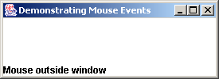
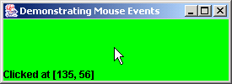
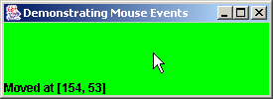

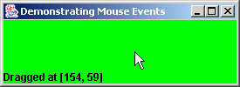
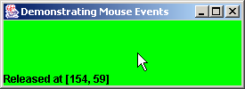
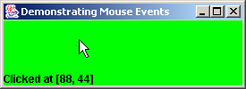
MouseTracker.java
79 public static void main( String args[] )
80 {
81 MouseTracker application = new MouseTracker();
82 application.setDefaultCloseOperation( JFrame.EXIT_ON_CLOSE );
83 }
84
85 } // end class MouseTracker

Slide 30
Adapter Classes
Adapter class
Implements interface
Provides default implementation of each interface method
Used when all methods in interface is not needed

Slide 31
Event-adapter classes and the interfaces they implement in package java.awt.event

Slide 32
Painter.java Line 22
1 // Fig. 13.19: Painter.java
2 // Using class MouseMotionAdapter.
3 import java.awt.*;
4 import java.awt.event.*;
5 import javax.swing.*;
6
7 public class Painter extends JFrame {
8 private int pointCount = 0;
9
10 // array of 1000 java.awt.Point references
11 private Point points[] = new Point[ 1000 ];
12
13 // set up GUI and register mouse event handler
14 public Painter()
15 {
16 super( "A simple paint program" );
17
18 // create a label and place it in SOUTH of BorderLayout
19 getContentPane().add( new JLabel( "Drag the mouse to draw" ),
20 BorderLayout.SOUTH );
21
22 addMouseMotionListener(
23
24 new MouseMotionAdapter() { // anonymous inner class
25
Register MouseMotionListener to listen for window’s mouse-motion events

Slide 33
Painter.java Line 27 Line 30 Line 51
26 // store drag coordinates and repaint
27 public void mouseDragged( MouseEvent event )
28 {
29 if ( pointCount < points.length ) {
30 points[ pointCount ] = event.getPoint();
31 ++pointCount;
32 repaint();
33 }
34 }
35
36 } // end anonymous inner class
37
38 ); // end call to addMouseMotionListener
39
40 setSize( 300, 150 );
41 setVisible( true );
42
43 } // end Painter constructor
44
45 // draw oval in a 4-by-4 bounding box at specified location on window
46 public void paint( Graphics g )
47 {
48 super.paint( g ); // clears drawing area
49
50 for ( int i = 0; i < points.length && points[ i ] != null; i++ )
51 g.fillOval( points[ i ].x, points[ i ].y, 4, 4 );
52 }
Override method mouseDragged, but not method mouseMoved
Store coordinates where mouse was dragged, then repaint JFrame
Draw circle of diameter 4 where user dragged cursor

Slide 34
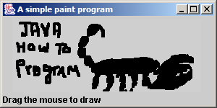
Painter.java
53
54 public static void main( String args[] )
55 {
56 Painter application = new Painter();
57 application.setDefaultCloseOperation( JFrame.EXIT_ON_CLOSE );
58 }
59
60 } // end class Painter

Slide 35
MouseDetails.java Line 15
1 // Fig. 13.20: MouseDetails.java
2 // Demonstrating mouse clicks and distinguishing between mouse buttons.
3 import java.awt.*;
4 import java.awt.event.*;
5 import javax.swing.*;
6
7 public class MouseDetails extends JFrame {
8 private int xPos, yPos;
9
10 // set title bar String; register mouse listener; size and show window
11 public MouseDetails()
12 {
13 super( "Mouse clicks and buttons" );
14
15 addMouseListener( new MouseClickHandler() );
16
17 setSize( 350, 150 );
18 setVisible( true );
19 }
20
21 // draw String at location where mouse was clicked
22 public void paint( Graphics g )
23 {
24 // call superclass paint method
25 super.paint( g );
26
Register mouse listener

Slide 36
MouseDetails.java Line 41 Lines 43-44 Line 46 Line 48 Line 51
27 g.drawString( "Clicked @ [" + xPos + ", " + yPos + "]",
28 xPos, yPos );
29 }
30
31 public static void main( String args[] )
32 {
33 MouseDetails application = new MouseDetails();
34 application.setDefaultCloseOperation( JFrame.EXIT_ON_CLOSE );
35 }
36
37 // inner class to handle mouse events
38 private class MouseClickHandler extends MouseAdapter {
39
40 // handle mouse click event and determine which button was pressed
41 public void mouseClicked( MouseEvent event )
42 {
43 xPos = event.getX();
44 yPos = event.getY();
45
46 String title = "Clicked " + event.getClickCount() + " time(s)";
47
48 if ( event.isMetaDown() ) // right mouse button
49 title += " with right mouse button";
50
51 else if ( event.isAltDown() ) // middle mouse button
52 title += " with center mouse button";
Invoke method mouseClicked when user clicks mouse
Store mouse-cursor coordinates where mouse was clicked
Determine number of times user has clicked mouse
Determine if user clicked right mouse button
Determine if user clicked middle mouse button

Slide 37
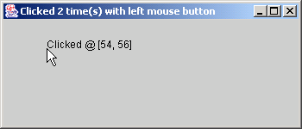
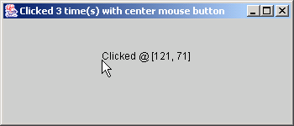
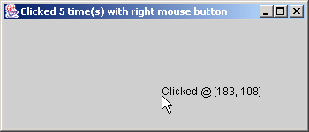
MouseDetails.java
53
54 else // left mouse button
55 title += " with left mouse button";
56
57 setTitle( title ); // set title bar of window
58 repaint();
59
60 } // end method mouseClicked
61
62 } // end private inner class MouseClickHandler
63
64 } // end class MouseDetails

Slide 38
Jump to

Slide 39
For the exam

Slide 42
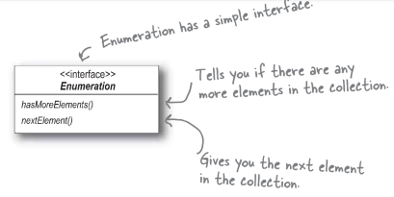
Ejemplo Real: de Enumeradores a Iteradores

Slide 43
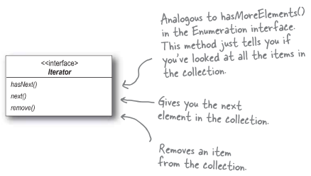
Ejemplo Real: de Enumeradores a Iteradores

Slide 44
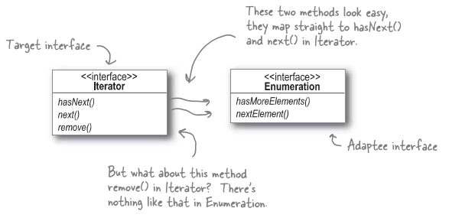

Slide 45
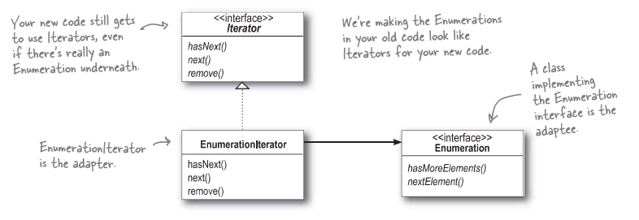

Slide 46
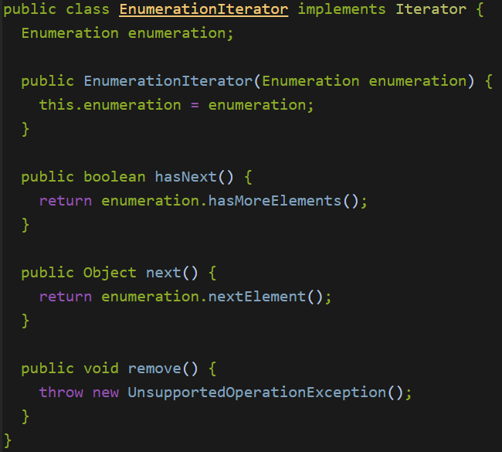

Slide 47
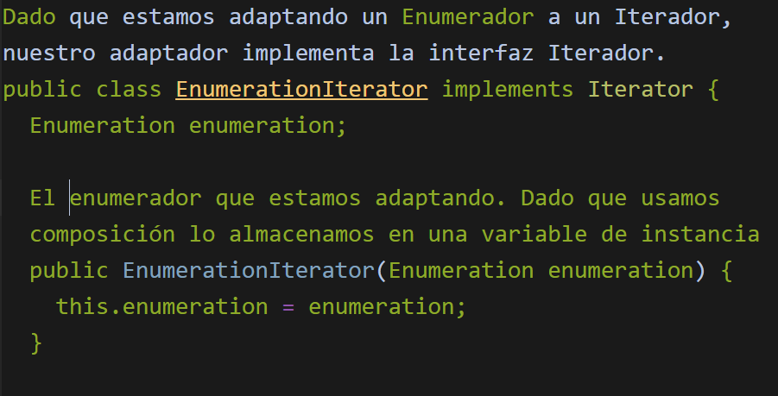

Slide 48
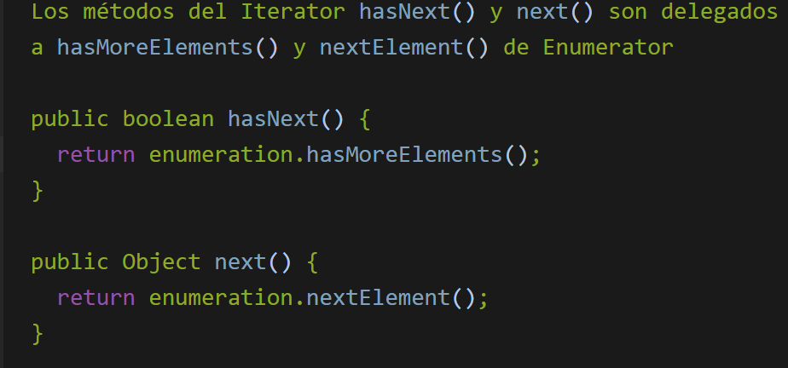

Slide 49
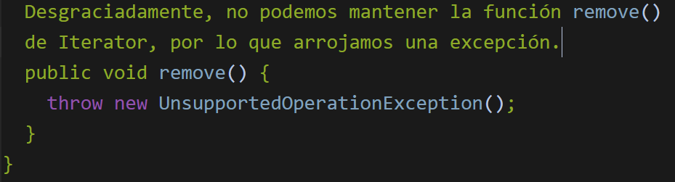

Slide 50
